Slide 1
SSI Auction in Ethereum Blockchain
Vincenzo Lapadula
Matricola n. 184586

Slide 2
Sequential Single-Item (SSI) Auctions
The targets are allocated in one multi-round auction.
During each round, every user bids on each unallocated target, and winner determination then allocates one additional target to one user.
Every user bids on a target the smallest increase in its total ‘tasks cost’ that would result from it being allocated the target that it bids on in addition to all targets allocated to it in previous rounds (marginal-cost bidding).
Winner determination determines bid with the smallest bid cost and allocates the corresponding target to the corresponding user.
Open the auction bidding new task
Biddders made their offers
Close the auction assigning the task to the user that offer the best marginal cost
Check if there is another task

Slide 3
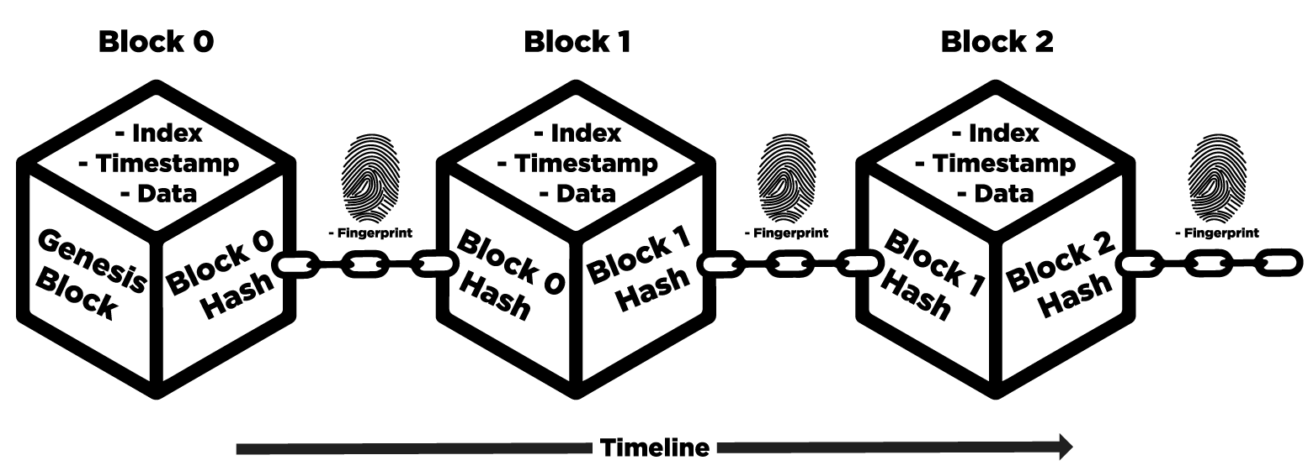
Blockchain: Ethereum
Blockchain is a peer-to-peer distributed ledger technology that provides a shared, immutable, and transparent append-only register of all the actions that have happened to all the participants of the network.
The data in the form of transactions, digitally signed and broadcasted by the participants, are grouped into the blocks in the chronological order and timestamped.
A hash function is applied to the content of the block and forms a unique block identifier, which is stored in the subsequent block.

Slide 4
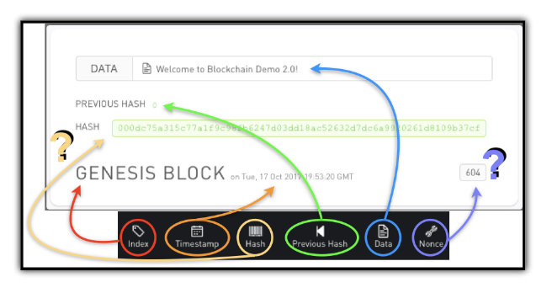
Blockchains can execute arbitrary tasks typically called smart contracts.
To add a new block to the ledger a consensus protocol is employed (Proof of Work). It is based on so-called “mining”: a process of looking for a nonce – a random number that is stored in every block – so that the resulting hash of a new valid block satisfies certain requirements (It set the difficulty threshold for the process of finding the nonce and determines the average number of hashes needed to mine one block).

Slide 5


Smart Contract: Solidity & Remix IDE
Solidity is a high-level, contract-oriented programming language designed for implementing smart contracts on various blockchain platforms, most notably Ethereum.
The language allows for the development of various decentralized applications, including voting systems, financial applications, games, identity and reputation systems, and more.
Remix IDE is a development environment designed specifically for smart contract development on the Ethereum blockchain.
It provides a set of tools and features as:
Solidity Integration;
Built-in Compiler;
Debugger;
Testing Environment;

Slide 6
Contract Structure
mapping(address => uint[]) userTasks;
mapping(string => address) assignedTarget;
address payable owner;
string object;
uint price;
uint endAt;
uint i = 0;
address winner;
uint256 best_offer;
bool is_open;
address[] users;
function open() public isOwner
function buildAuction(string memory _obj, uint256 _price) public isOwner
function startAuction() public isOwner
function checkOtherTasks() public view isOwner returns (bool status)
function close() public isOpened isOwner
function makeOffer(uint value) public isOpened
function offer() public isOpened
function assignTask() public isOwner

Slide 7
How does it work?
startAuction()
assignTask()
offer()
checkOtherTasks
buildAuction
open
makeOffer

Slide 8
Tasks assignment
function offer() public isOpened{
uint totalActualCosts = 0;
for(uint j = 0; j < userTasks[msg.sender].length; j++){
totalActualCosts += userTasks[msg.sender][j];
}
makeOffer(totalActualCosts + targetCosts[i]);
}
function assignTask() public isOwner {
require(msg.sender == owner, "Only the owner can assign the task");
require(is_open == false, "The auction is still opened");
emit WinningWithdrawn(winner, object);
assignedTarget[targets[i]] = winner;
userTasks[winner].push(targetCosts[i]);
}

Slide 9
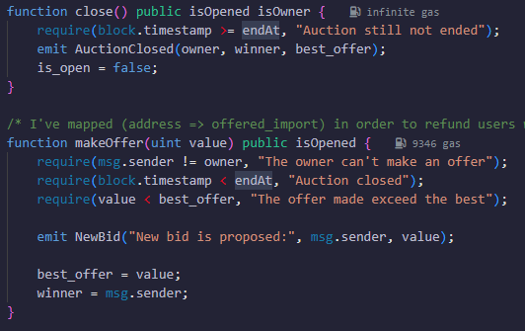
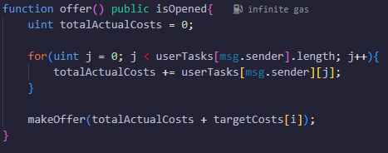
About safeness?
block.timestamp < endAt: It must be considered that the block timestamp can be slightly manipulated by miners.
The offer function works by iterating over an array. If this becomes excessively large, it can lead to reaching the Block Gas Limit.

Slide 10


Thank you for listening
https://github.com/Theviki20110/MultiAgentBlockchain

